Slide 1
SOCIAL MEDIA & CONTENT MARKETING PORTFOLIO
LEIMKUEHLER MEDIA
Katie Leimkuehler CEO & Social Media Consultant www.katieleimkuehler.com

Slide 2
About Katie Leimkuehler
HIGHLIGHTS OF EXPERIENCE
Senior Manger, Social Media Coach at Charles Schwab
Social Media and PR Professor at University of Denver
Social Media Director at ISA
Social Media Manager at IIDA
Journalist at the Chicago Tribune
EXPERTISE
Social Media Strategy
Social Media Analytics
Social Media Advertising
Content Marketing
Public Relations
Digital Branding
CEO & Social Media Consultant of Leimkuehler Media

Slide 3
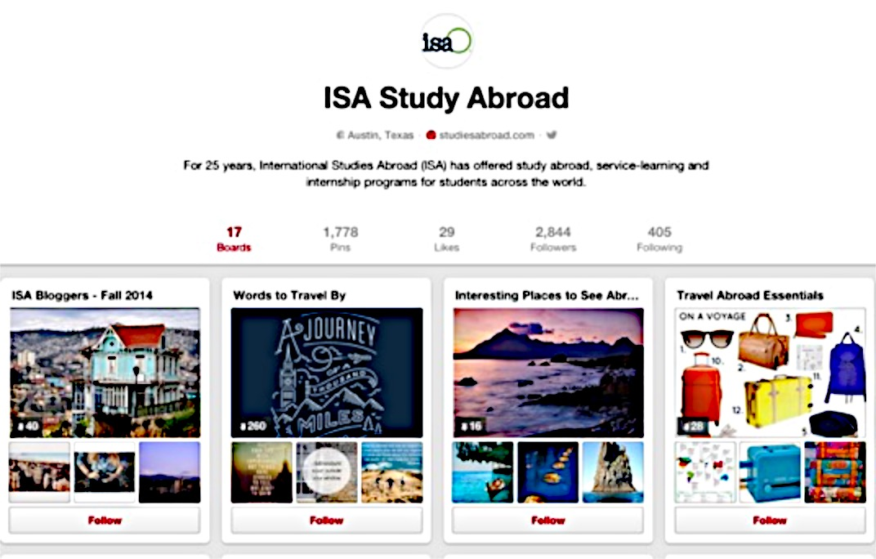
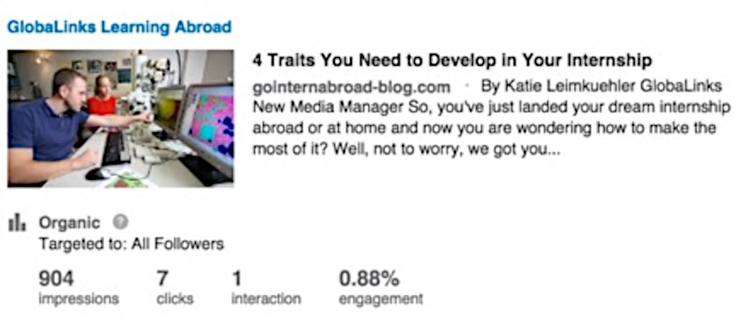
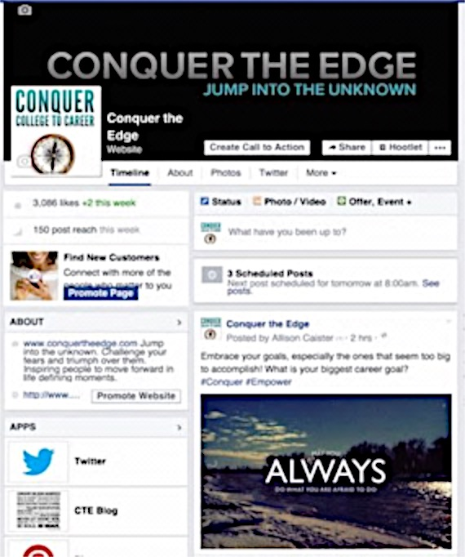
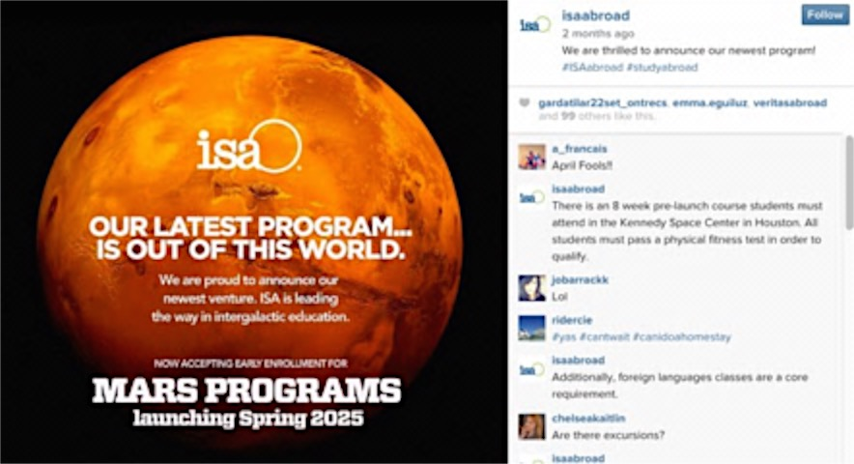
Social Media Channels
PINTEREST
TWITTER
LINKEDIN
FACEBOOK
INSTGRAM

Slide 4
Courses Taught
Integrating Social Media
Copywriting for Social Media
PR Writing
PR Principles and Processes
English Composition

Slide 5
Social Media Analysis
I will do a complete review all of your social media channels including Facebook, Twitter, LinkedIn, Pinterest and Instagram and evaluate what has been successful, what needs improvement, what isn’t working and provide examples of these.
The analysis will examine the type of content you are posting, the sources of that content, posting frequency and the engagement from your fans and followers.
This includes tips and tactics to engage your audience, defining your voice, methods to connect with potential customers and top influencers, and ways of measuring your influence.
Based on my findings I will make recommendations for each of your social media channels on the best practices and strategies to implement.

Slide 6
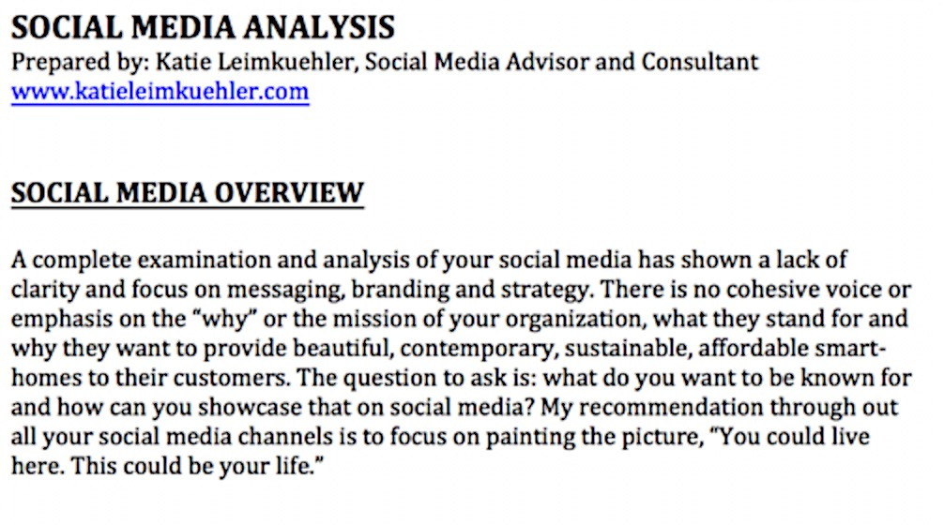
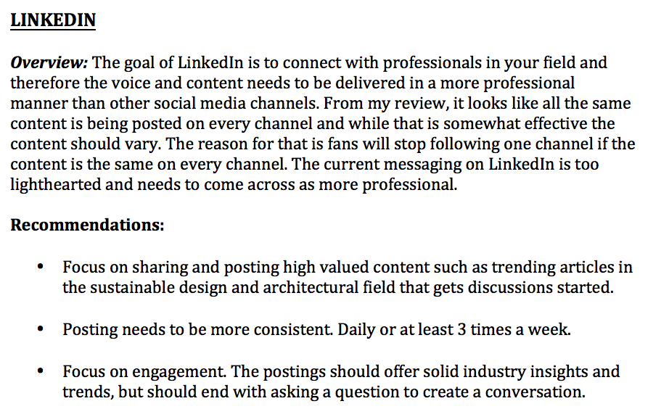
Social Media Analysis Results

Slide 7
Social Media Strategy & Action Plan
The Social Media Strategy & Action Plan will help you plan your week on all of your social media channels from the type of content you should share, the content you should be re-sharing from other big players and social influencers, and the recommended responses to your fans and followers to increase engagement.
This detailed plan will include specific numbers you should be working towards each week such as the number of retweets, responses and favorites on Twitter, and the number of shared Facebook postings from other relevant pages, etc.
The action plan will include a weekly structure and breakdown steps that needs to be implemented for each social channel.
Along with the plan I will provide a recommended hashtag list for your specific industry and ways to find and monitor conversations to join.
The plan will be a complete blueprint of how to best implement your social media strategy.

Slide 8
Social Media Content Calendar
Weekly break down of your social media on each channel.
Calendar is created a month in advance and schedule out.

Slide 9
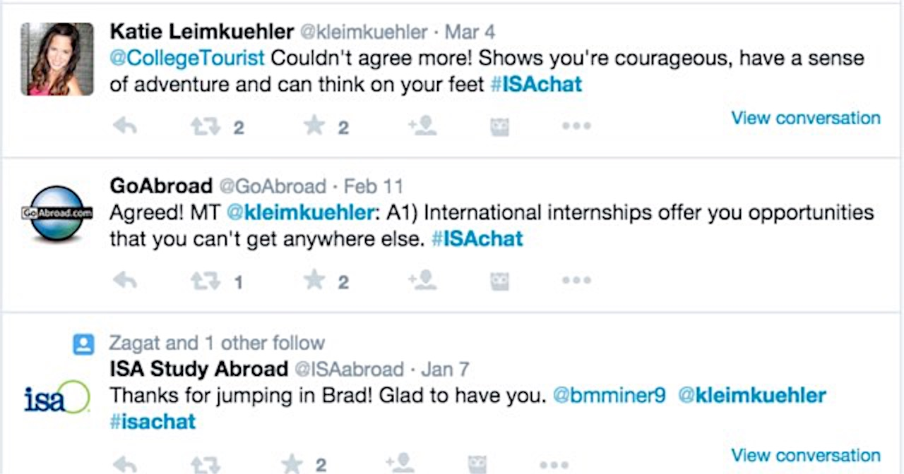
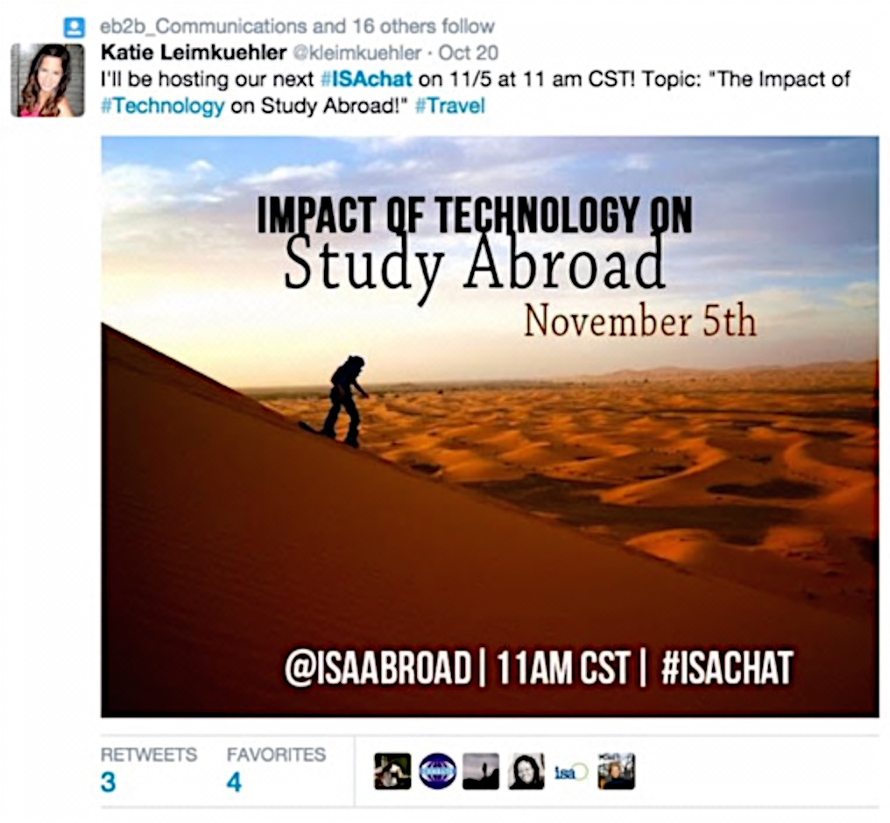
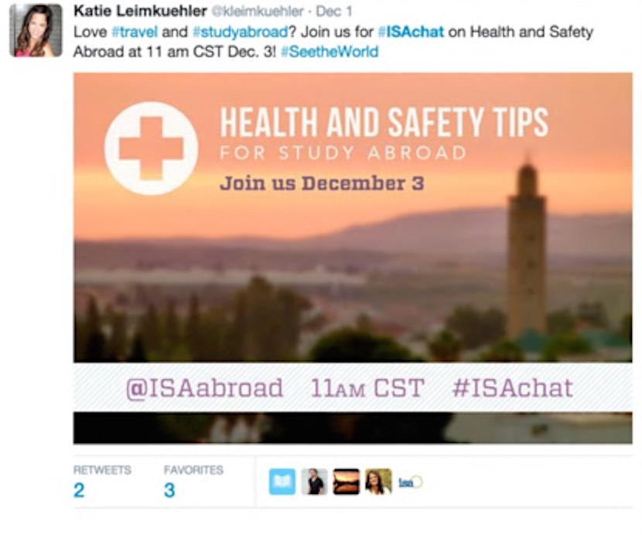
Hosting Twitter Chats - #ISAChat
Initiated brand new Twitter Chat for ISA called #ISAchat.
Hosted the chat the first Wednesday of each month for 1 hour.
New topics each month including: health abroad, choosing a study abroad program & technology abroad among others.

Slide 10
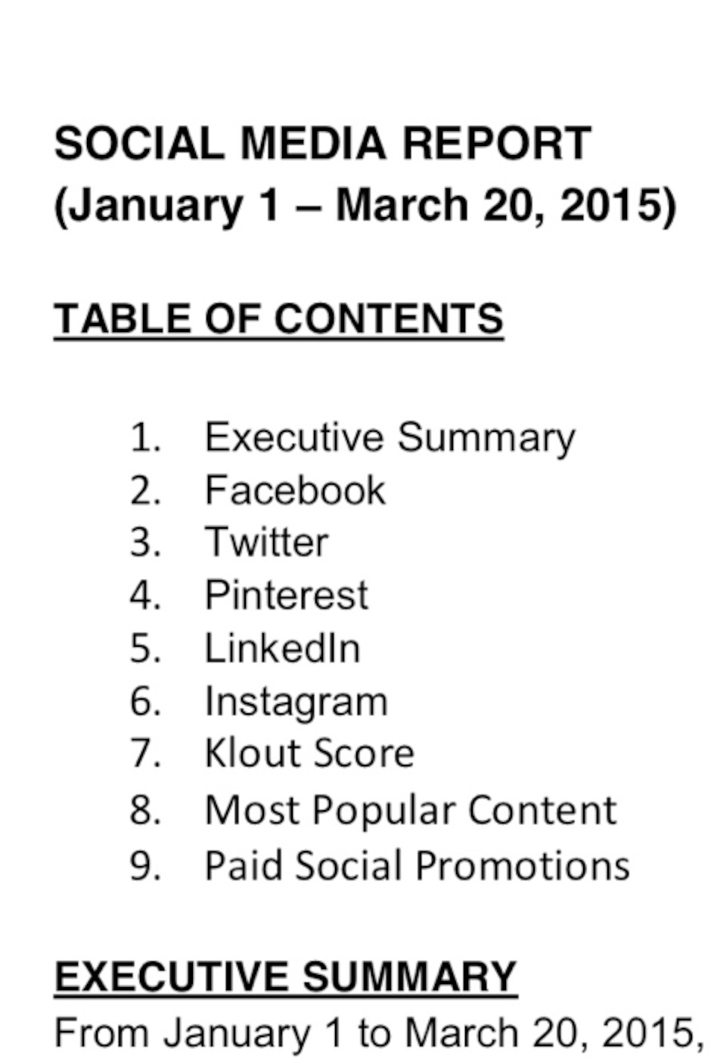
Social Media Analytic Reports
Social media reports include:
Growth in followers on each channel.
New trends & hashtags
Most popular content (Facebook posts, Tweets, Pins etc.)
Key influencers.
Overall social media score from all channel – Klout Score.

Slide 11
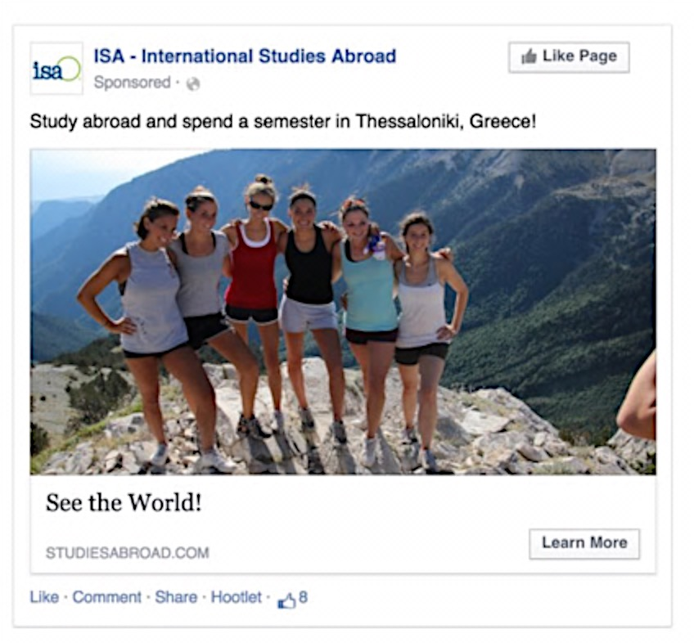
Facebook Advertising
Facebook Advertising for business to consumers.
On average 30% increase to website traffic.

Slide 12
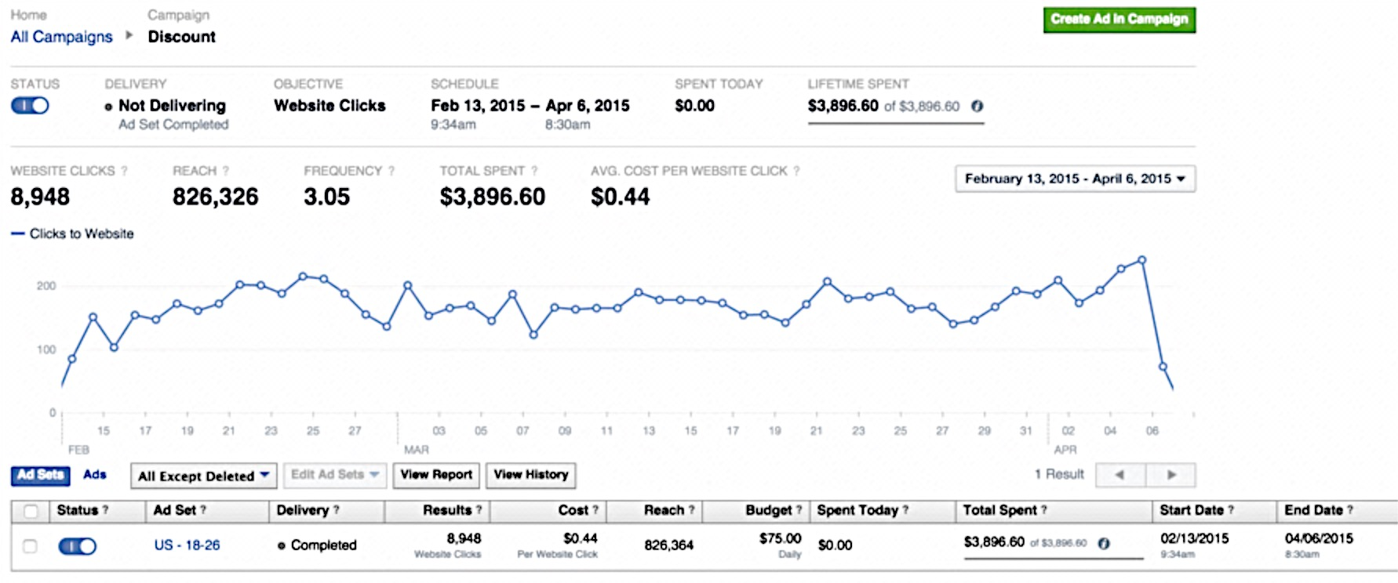
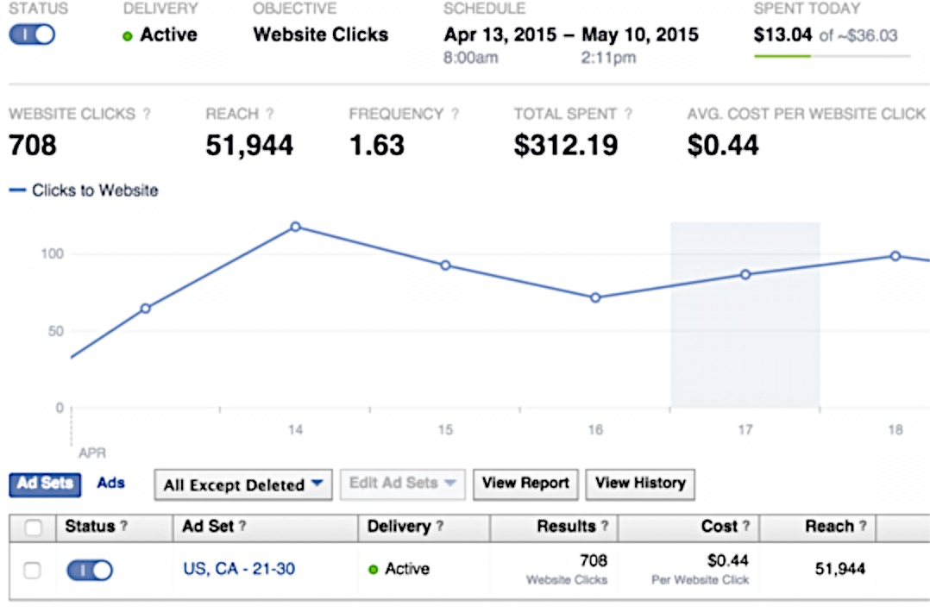
Advertising Results
Ran monthly campaigns resulting in over 8,000 website clicks.
Reach to mover 800,000 people
Average cost per click .44 cents

Slide 13
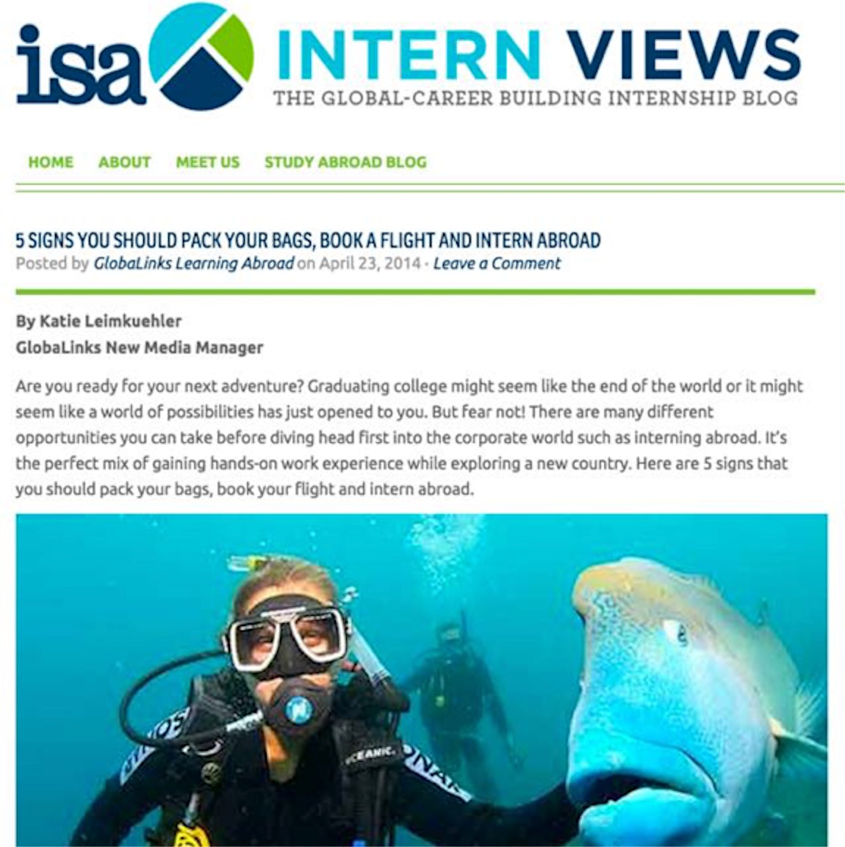
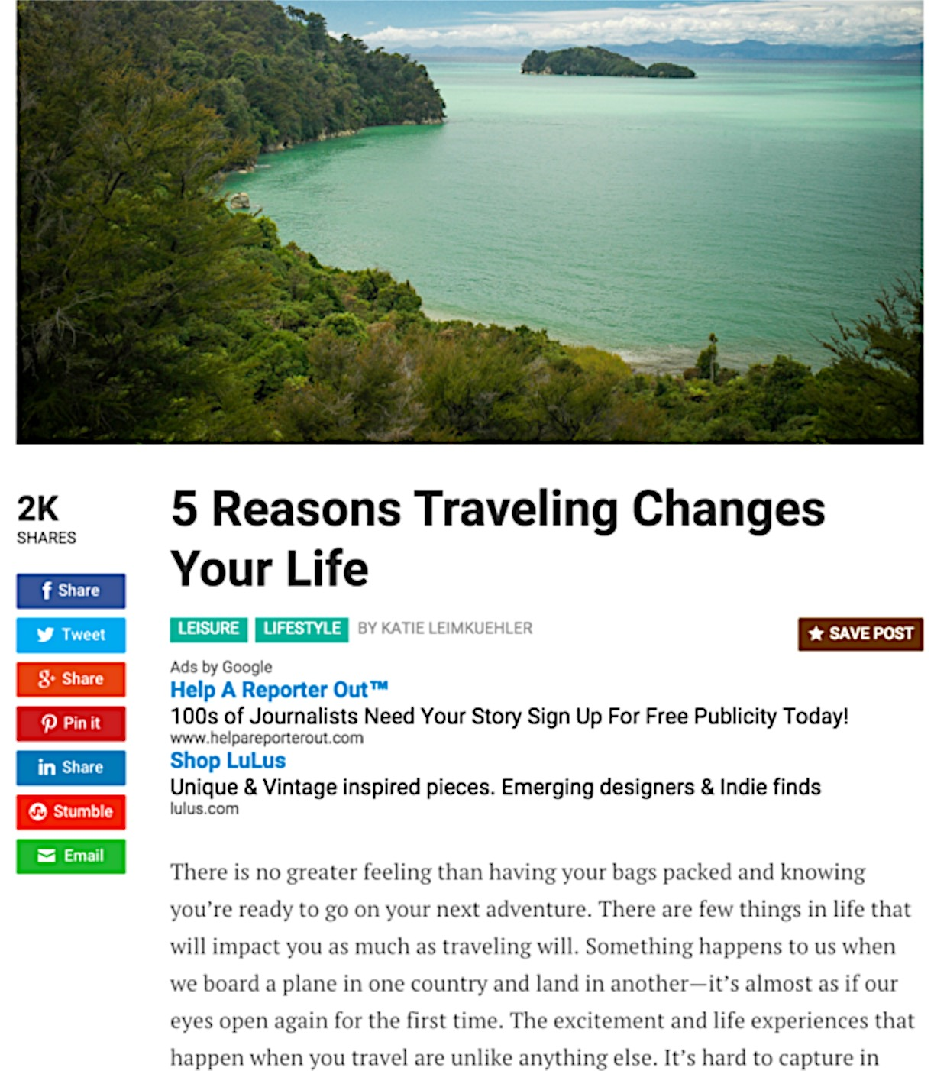
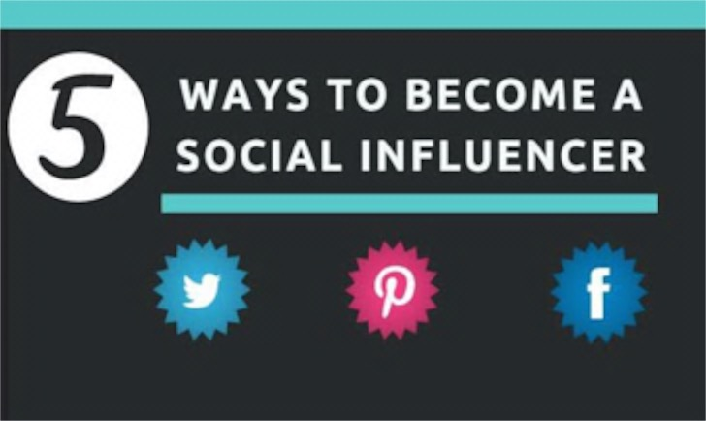
Blogging
Publications (Click for writing samples)
Social Media Today
Lifehack
Technori
Built In Colorado
LinkedIn
Networlding

Slide 14
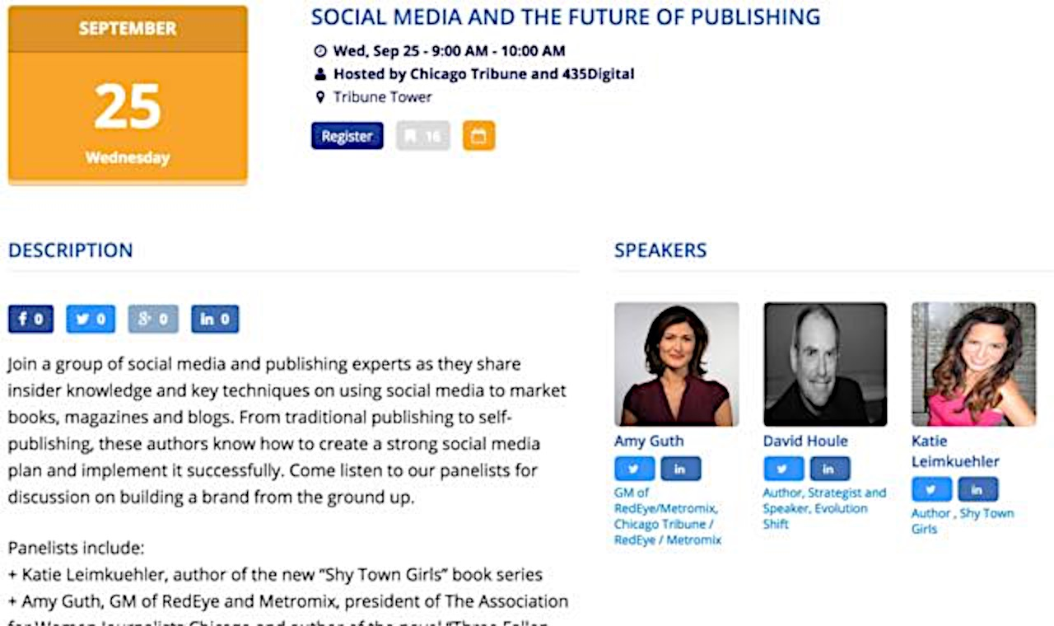
Social Media Speaking
Sample Talk Titles:
How to Create a Dynamite Social Media Strategy for Your Business
6 Steps to Launch Your Social Media from the Ground Up
5 Key Strategies to Create a Blog that People Will Share
Leveraging LinkedIn: 5 Unbeatable Methods to Become an Influencer
The 5 Keys to Building Relationships in Social Media

Slide 15
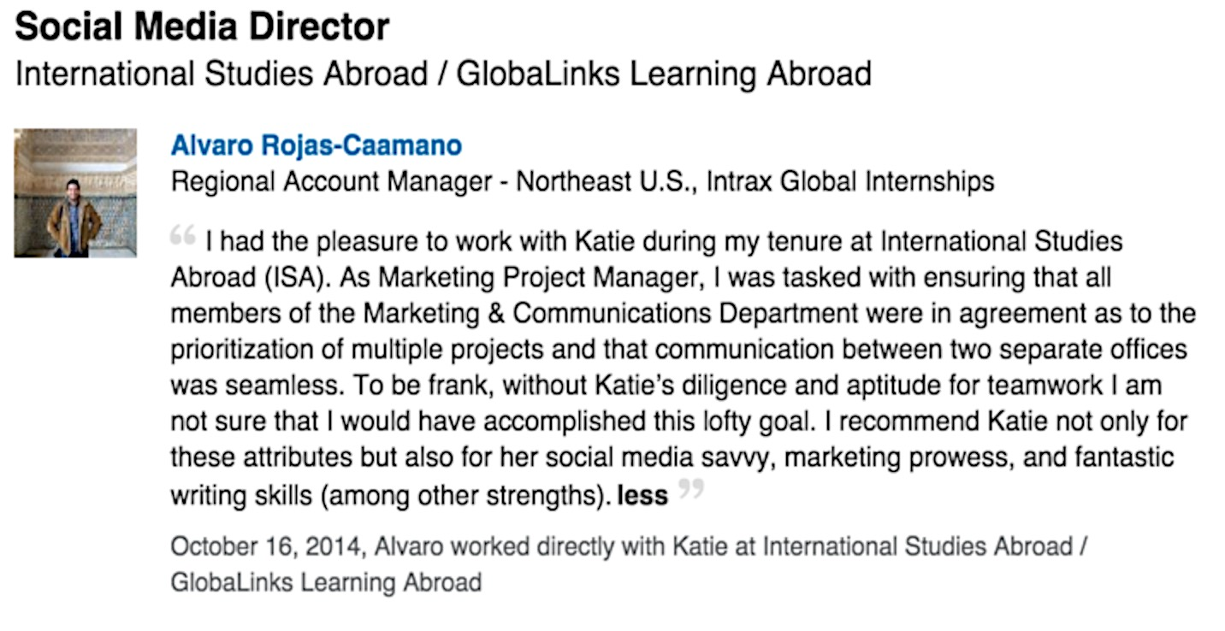
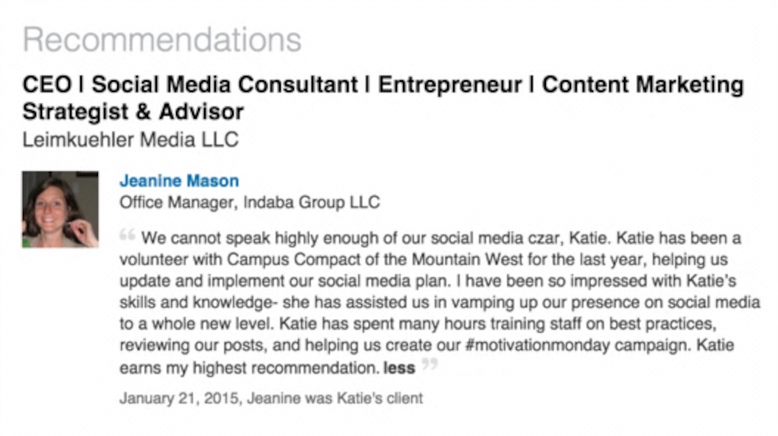
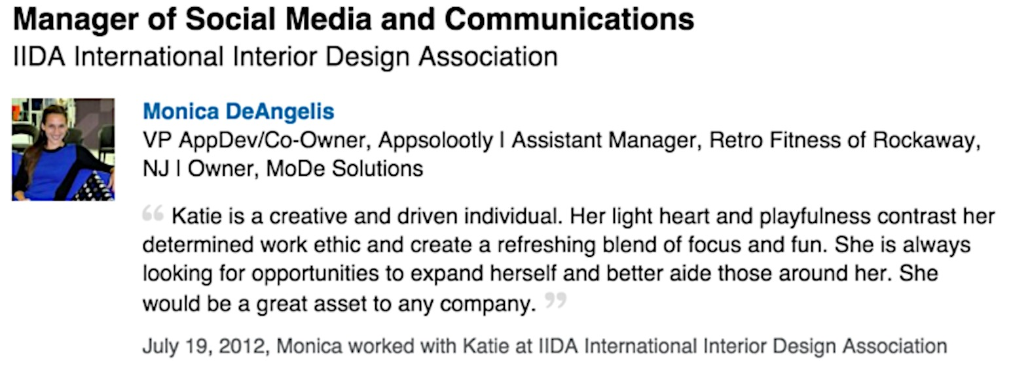
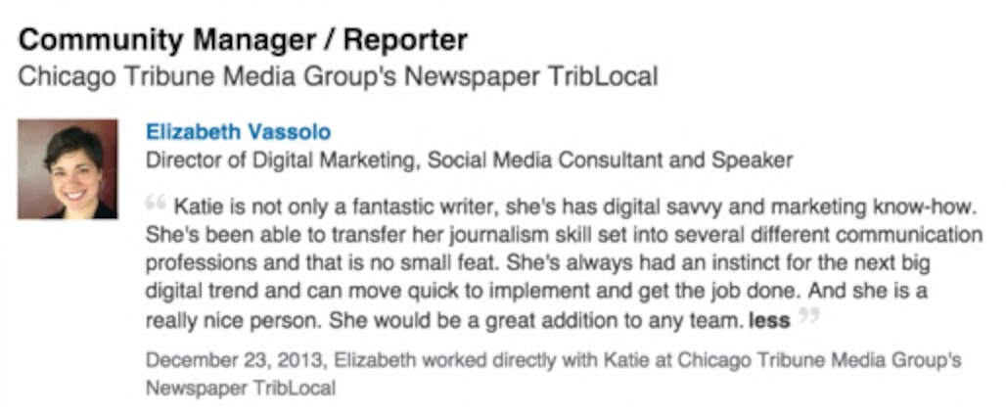
Recommendations

Slide 16
Credentials
CEO of Leimkuehler Media
MFA in writing from Roosevelt University
Teaching Certificate from Roosevelt University
BA in journalism and creative writing and minor in business from Miami University of Ohio
9 years in public relations and social media

Slide 17
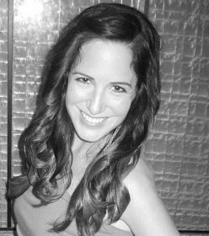
Contact Katie Leimkuehler
Twitter LinkedIn http://www.linkedin.com/in/katieleimkuehler
Email katieleimkuehler@gmail.com Phone 440-935-5023
Website www.katieleimkuehler.com
@Kleimkuehler

